Slide 1
GEOLOGIST LICENSURE AT THE SECTION LEVEL

Slide 2
LICENSURE COMMITTEE MEMBERS
Ken Neal, Chair (Washington)
Charles Nestle, Vice Chair (So. California)
Raymond Knox, Secretary (Carolinas)
Stephen Mogilnicki (Baltimore-Washington-Harrisburg)
Duane Eversoll (Kansas City-Omaha)
Kevin Coleman (Texas)
William Godwin (San Francisco)
Chris Humphrey (Oregon)
Peter Thams (Southern California)
Marty Goff (Baltimore-Washington-Harrisburg)
Jennifer Bauer (Carolinas – E.C. Rep)
Paul Hale (Allegheny-Ohio – E.C. Rep)

Slide 3
Authority for & Purpose of Licensure
Police power granted to states by the US Constitution
Purpose is to protect the public safety, health, and welfare, and the environment.
Purpose of licensure is NOT to promote or improve the status of a profession

Slide 4
Roles and Responsibilities
Licensure is a state issue
Issues resolved locally
Primary section-level involvement
AEG national can provide support

Slide 5
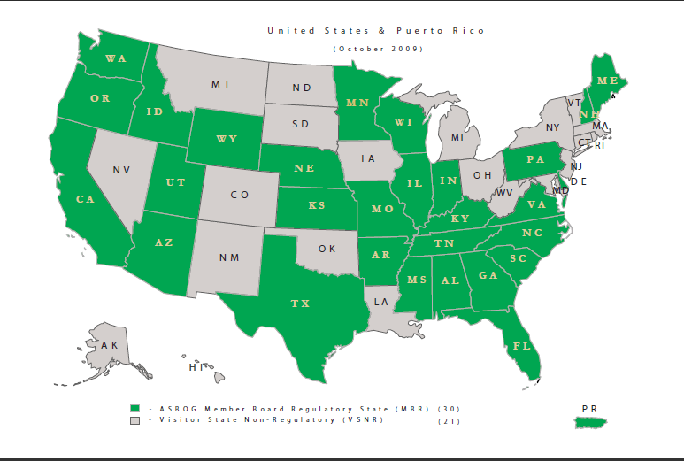

Slide 6
THE LC NEEDS HELP FROM SECTIONS
SECTION REPRESENTATIVES FROM EACH STATE NEEDED TO MONITOR LEGISLATIVE ACTIVITY PERTINENT TO PRACTICE OF GEOLOGY.
STANDARD OPERATING PRACTICE UNDER DEVELOPMENT FOR LINKING SECTION EFFORTS TO THE LICENSURE COMMITTEE.

Slide 7
Conclusions:
Legislative Activities (including lobbying) are state-level activities
Hiring of lobbyists necessary to be successful

Slide 8
Legal Implications
AEG is a § 501(c)(6) organization (includes "business leagues", trade associations, professional associations, chambers of commerce, real estate boards, and boards of trade.
§ 501(c)(6) organizations are permitted to engage in lobbying, so long as the lobbying serves the common interest of the members of the organization.
Cannot lobby for candidates.
Dues used for lobbying are not tax-deductable.

Slide 9
How Much Does Lobbying Cost?
Depends on location (generally, large states are more expensive than small states)
Washington cost ~$2,500/month for “good” lobbyist (~$12,000 per legislative session)
California: $12,000 for minimal services, $40,000/year for proposed legislation, could go to $100,000/year for major effort
Less populated states like Montana and Wyoming may be considerably less

Slide 10
Lobbying is a necessary (but expensive) evil that is needed if we are to succeed with our legislative efforts

Slide 11
HOW CAN SECTIONS RAISE MONEY FOR LEGISLATIVE EFFORTS?
PORTION OF LOCAL DUES
FUNDRAISERS

Slide 12
When Can Sections Fund Legislative Efforts?
Continuously (plan ahead for potential need)
When needed (crisis mode)

Slide 13
PROPOSED ASSISTANCE FUND FOR LEGISLATIVE EFFORTS
Purpose is to assist sections in their licensure and/or legislative efforts
Supplement local funding
Provide assistance for funding a lobbying effort.
Established internally within AEG

Slide 14
HOW MUCH $$$?
Initial budget of $10,000 in FY 2012, with a second $10,000 in 2013.
Goal is to maintain fund at a minimum level of $20,000 (not a significant part of our overall budget).
The fund total could be adjusted periodically to reflect current costs.
Non-deductible dues increase proposed to provide funding

Slide 15
How Do We as a Section Want to Approach Licensure and Other Legislation Affecting Our Profession?
Support AEG’s role in promoting licensure?
Participate in LC Function?
Support financial participation by AEG?
Should section be proactive or reactive?
Support use of dues for legislative efforts (local? National?)?
Dues increase? How much?

